Slide 1
ER Model Design Choices

Slide 2
ISA (`is a’) Hierarchies (1)
name
ssn
lot
Employees
hourly_wages
hours_worked
ISA
Attributes are inherited.
If we declare A ISA B, every A entity is also considered to be a B entity.
contractid
Hourly_Emps
Contract_Emps
Employees are SPECIALIZED into subclasses
Identifying subsets of an entity set that share some distinguishing characteristic
Hourly_emps & Contract_emps are GENERALIZED by Employees
Notes:
12

Slide 3
ISA (`is a’) Hierarchies (2)
Overlap constraints: Can Megha be an Hourly_Emps as well as a Contract_Emps entity?
No overlap is Default
Hourly employee OVERLAPS contract employee
Covering constraints: Does every Employees entity also have to be an Hourly_Emps or a Contract_Emps entity?
No covering is Default
Hourly employee AND Contract employee COVER Employee

Slide 4
ISA (`is a’) Hierarchies (3)
2 basic reasons for identifying subclasses (by specialization or generalization):
  We want to add descriptive attributes that apply only to entities in a subclass
  Identify the set of entities that participate in some relationship for eg. Only senior employees could be managers
  Want to add few more categories/subclasses in future (extendibility)

Slide 5
Review - Our Basic ER Model
Entities and Entity Set (boxes)
Relationships and Relationship sets (diamonds)
  binary
  n-ary
Key constraints (1-1,1-M, M-M, arrows on 1 side)
Participation constraints (bold for Total)
Weak entities - require strong entity for key
Aggregation - an alternative to n-ary relationships
ISA hierarchies - abstraction and inheritance

Slide 6
E-R Modeling : Noun Analysis
Gather domain knowledge and requirements by using appropriate combination of various fact finding techniques
Develop description of the problem
Description contains several nouns and verbs
Analyze problem description using noun analysis method
Noun and verb lists are analyzed using various criteria
Get truncated list of nouns using these criteria
The things that each entity is suppose to know form list of attributes
Some of the nouns become attributes

Slide 7
Noun Analysis (2)
  To analyze the list of the nouns & reject those that are unsuitable for use as the basis for entities.
  Duplicates: if two or more nouns are simply names for the same thing, then only one of these should be used as the basis for an entity
  Irrelevant : entities which exist in the problem domain but which are not part of the intended system should also be discarded

Slide 8
Noun Analysis (3)
  Vague: When considering words carefully it sometimes become
  clear that they do not have a precise meaning and cannot be basis for useful entity in the system
  General: Some words are too general
  Attributes: Some words we want to keep as a part of some entity and not an entity itself
  Associations: some words actually represent a relationship between entities

Slide 9
Conceptual Design Using the ER Model
Design choices
  Should a concept be modeled as an entity or an attribute?
  Should a concept be modeled as an entity or a relationship?
  Identifying relationships: Binary or ternary? Aggregation?
Constraints in the ER Model:
  A lot of data semantics can (and should) be captured
  But some constraints cannot be captured in ER diagrams
    We will refine things in relational design
Notes:
3

Slide 10
Entity vs. Attribute
Should address be an attribute of Employees or an entity (connected to Employees by a relationship)?
Depends upon the use we want to make of address information, and the semantics of the data:
    If we have several addresses per employee, address must be an entity (since attributes cannot be set-valued)
    If the structure (city, street, etc.) is important, e.g., we want to retrieve employees in a given city, address must be modeled as an entity (since attribute values are atomic)

Slide 11
Entity vs. Attribute (Contd.)
from
to
name
dname
ssn
lot
did
budget
Works_In4 does not allow an employee to work in a department for two or more periods.
Similar to the problem of wanting to record several addresses for an employee: We want to record several values of the descriptive attributes for each instance of this relationship. Accomplished by introducing new entity set, Duration.
Employees
Works_In4
Departments
name
dname
ssn
lot
did
budget
Employees
Works_In4
Departments
from
Duration
to
Notes:
5

Slide 12
Entity vs. Relationship
since
dbudget
name
dname
First ER diagram OK if a manager gets a separate discretionary budget for each dept.
What if a manager gets a discretionary budget that covers all managed depts?
  Redundancy: dbudget stored for each dept managed by manager.
  Misleading: Suggests dbudget associated with department-mgr combination.
ssn
lot
did
budget
Employees
Manages2
Departments
name
ssn
lot
since
dname
Employees
did
budget
Manages2
Departments
ISA
This fixes the
problem!
Managers
dbudget
Notes:
6

Slide 13
These things get pretty hairy!
Many E-R diagrams cover entire walls!
A modest example:

Slide 14
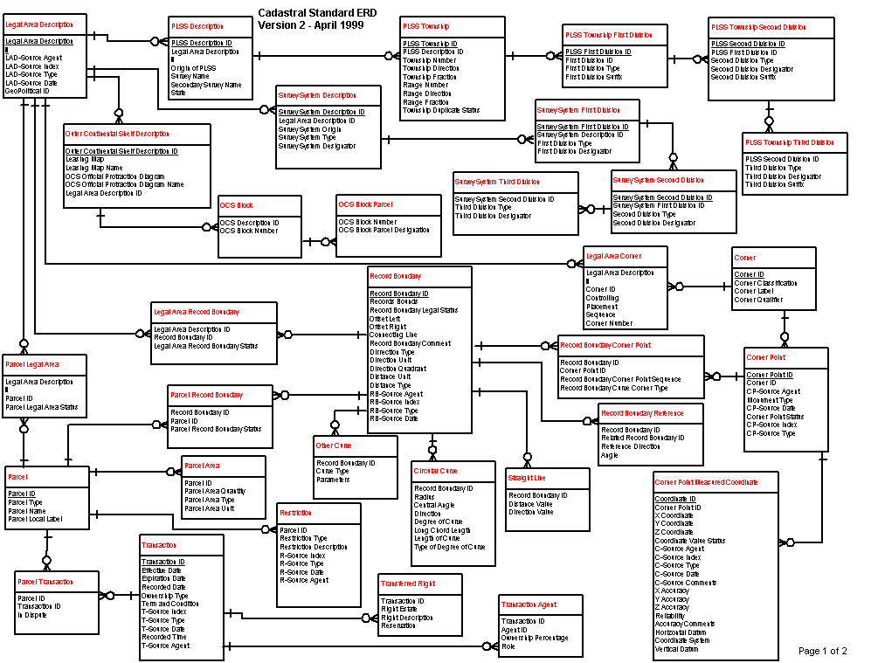
A Cadastral E-R Diagram

Slide 15
A Cadastral E-R Diagram
cadastral: showing or recording property boundaries, subdivision lines, buildings, and related details
Source: US Dept. Interior Bureau of Land Management,
Federal Geographic Data Committee Cadastral Subcommittee
http://www.fairview-industries.com/standardmodule/cad-erd.htm

Slide 16
Binary vs. Ternary Relationships
name
ssn
lot
pname
age
Employees
Covers
Dependents
If each policy is owned by just 1 employee, and each dependent is tied to the covering policy, first diagram is inaccurate.
What are the additional constraints in the 2nd diagram?
Bad design
Policies
policyid
cost
name
pname
age
ssn
lot
Dependents
Employees
Purchaser
Beneficiary
Better design
Policies
policyid
cost
Notes:
7

Slide 17
Relationships
Covers
An employee can own several policies
Each policy can be owned by several employees
Each dependent can be covered by several policies
More Constraints
A policy can not be owned jointly by 2 or more employees (then policy covers only one dependent)
Every policy must be owned by some employee (then each policy covers at least one dependent)
Dependents is a weak entity. (should be represented through a binary relationship with identifier)

Slide 18
New Constraints
Employee can be identified by ssn
Employee can purchase several policies
Policy can be purchased by only one employee
Every policy must be purchased by an employee
Policy benefits several dependents
A dependent gets benefited by one policy
Every dependent must get benefited by a policy
Dependents is a weak entity set
Beneficiary is a relationship connecting weak entity set with strong/owner entity set
Pname is partial key for dependents
Identifier for dependents is (pname, policyid)

Slide 19
Binary vs. Ternary Relationships (Contd.)
Previous example illustrated a case when two binary relationships were better than one ternary.
An example in the other direction: a ternary relation Contracts relates entity sets Parts, Departments and Suppliers, and has descriptive attribute quantity.
  No combination of binary relationships is an adequate substitute.
quantity
Parts
Contract
Departments
Suppliers
Notes:
9

Slide 20
Binary vs. Ternary Relationships (Contd.)
quantity
Parts
Contract
Departments
VS.
Suppliers
Parts
needs
Departments
can-supply
Suppliers
deals-with
  S “can-supply” P, D “needs” P, and D “deals-with” S does not imply that D has agreed to buy P from S.
  How do we record qty?
Notes:
9

Slide 21
Aggregation
Relationship set is an association between entity sets
A relationship between collection of entities and relationships is modeled through aggregation
Example
  Project entity is sponsored by one or more Departments
  A department sponsoring a project might assign an employee to monitor the sponsorship
  Monitors should be a relationship set that associates a Sponsors relationship than department or project entity
Aggregation allows us to indicate that a relationship set (dashed box) participates in another relationship set
This allows us to treat Sponsors as an entity set for purpose of defining Monitors relationship set

Slide 22
Aggregation (2)
name
ssn
lot
Employees
Monitors
until
Used when we have to model a relationship involving (entitity sets and) a relationship set
  Aggregation allows us to treat a relationship set as an entity set for purposes of participation in (other) relationships
started_on
since
dname
pid
pbudget
did
budget
Projects
Sponsors
Departments
Aggregation vs. ternary relationship:
Monitors is a distinct relationship,
with a descriptive attribute
Also, can say that each sponsorship
is monitored by at most one employee
Notes:
2

Slide 23
Aggregation Vs Ternary Relationships
Choice guided by:
Existence of a relationship that relates a relationship set to an entity set ( or second relationship set)
Certain integrity constraints that we want to express
Project can be sponsored by any( 0 or more) number of departments
Department can sponsor one or more projects
Sponsorship is monitored by 0 or more employees
If descriptive attribute of Sponsors is not needed to be recorded and it has total participation in Monitors, every possible instance of Sponsors can be obtained from (pid,did) columns of Monitors and Sponsors can be dropped.

Slide 24
Aggregation Vs Ternary Relationships (2)
Constraint that each sponsorship (of a project by a department) be monitored by at most one employee (cant be expressed by Sponsors2 ternary relationship)
But can easily be expressed by aggregated relationship Sponsors to the Monitors

Slide 25
Recursive Relationships
An entity set can participate more than once in a relationship
In this case, a description of the role to the ER-diagram is added
manager
ssn
Employee
Manages
worker
name
lot

Slide 26
How to build E-R Diagram
Identify entities: Identify roles, events, locations, tangible things, concepts about which users want to store data
Find relationships: Find natural association among entities
Draw rough E-R Diagram
Cardinality: Determine number of occurrences of one entity for the single occurrences of another in a relationship
Define PK: identify PK for each entity set
Add key information to ERD
Identify attributes
Draw full ERD

Slide 27
Design Choices (1)
Avoid redundancy.
Limit the use of weak entity sets.
Don’t use an entity set when an attribute will do.

Slide 28
Design Choices (2)
Redundancy = saying the same thing in two (or more) different ways.
Wastes space and (more importantly) encourages inconsistency.
  Two representations of the same fact become inconsistent if we change one and forget to change the other.
  Recall anomalies due to FD’s

Slide 29
Design Choices (3)
1:1 relationships may indicate a mistake in conceptual model
Eliminate composite attributes
Eliminate multi-valued attributes
Eliminate derived attributes

Slide 30
Developing an ERD
Iterative Process
  Step1: General narrative of organizational operations is developed
  Step2: Basic E-R Model is depicted and reviewed
  Step3: Modifications are made to incorporate newly discovered E-R components
Repeat process until designers and users agree E-R Diagram complete

Slide 31
Summary
ER design is subjective. There are often many ways to model a given scenario! Analyzing alternatives can be tricky, especially for a large enterprise. Common choices include:
  Entity vs. attribute, entity vs. relationship, binary or n-ary relationship, whether or not to use ISA hierarchies, and whether or not to use aggregation.
Ensuring good database design: resulting relational schema should be analyzed and refined further. FD information and normalization techniques are especially useful.
Notes:
13

